Slide 1
Identifying the key drivers of electricity price spikes in the Australian National Electricity Market
A Machine Learning Approach
Thi Hau Nguyen

Slide 2
Table of contents
01
04
02
03
Introduction
Methodology
Objective
05
Interpretation and Findings
06
Conclusion
Data Overview and Processing
Link on GitHub: https://github.com/HauNguyen8689/Introduction-to-Machine-Learning-Supervised-Learning

Slide 3
01
Introduction

Slide 4
Electricity price spikes ?
Context:
With the next federal election set for May 3, 2025, electricity prices are a major issue.
Coalition blames renewables under Labor’s Capacity Investment Scheme (CIS)
Labor blames fossil gas generation in the National Electricity Market (NEM)
Industry Insight:
Natural gas is commonly seen as the "peaker" — the fuel that sets prices during demand spikes.
Objective:
Use machine learning to unbiasedly investigate drivers of high wholesale prices (above 95th percentile) across NEM regions.
Method:
Models: Random Forest & XGBoost
Features: Fuel types, dispatch shares, and time-based patterns
Outcome: Identify which factors most influence price spikes, regionally and temporally

Slide 5
02
Objective

Slide 6
NEM Overview:
Australia’s NEM spans 5 regions (NSW/ACT, QLD, VIC, SA, TAS), operating a real-time wholesale market managed by AEMO.
Dispatch & Settlement: Every 5 minutes, matching supply and demand to ensure grid stability and efficiency.
Challenge:
The complexity of the NEM makes it difficult to pinpoint what drives price spikes.
Study Aim:
Classify high-price events (above 95th percentile) and identify conditions linked to these spikes.
Classification Goal:
Determine which factors act as:
"Peakers" – linked to price spikes
"Non-Peakers" – linked to normal pricing

Slide 7
03
Data Overview and Processing

Slide 8
Data Sources
Source: Historical electricity data from AEMO (April 1, 2024 – March 31, 2025)
Contents:
Regional demand and price
Generator dispatch & capacity (by DUID)
Generator metadata (fuel type, region)
Resolution: Originally at 5-minute intervals, aggregated to hourly — sufficient for capturing price spikes
Format: Stored in CSV, uploaded to Kaggle for easy access (https://www.kaggle.com/datasets/baohoangnguyen/nem-hourly-dispatch)

Slide 9
Data Processing
The original dataset contained approximately 3.5 million observations. It was then cleaned and aggregated by fuel type. The final dataset used for modeling consists of 276,201 observations
Dependent Variable (Target)
Independent Variables (Features)
Peaker = 1 for prices ≥ 95th percentile
Non_Peaker = 0 for prices < 95th percentile
Hour: Hour of day (0–23)
DayofWeek: Day of the week
Month: Month of the year
Prop: Proportion of total dispatch by each fuel type
FuelType: Fuel type
Region: One of the 5 NEM regions.

Slide 10
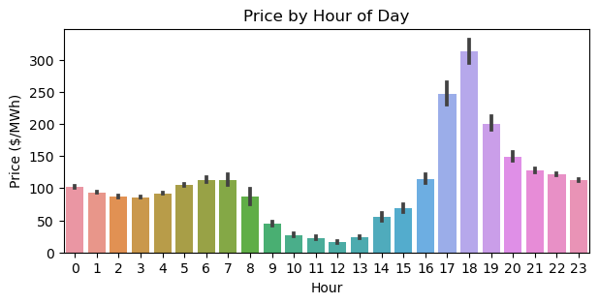
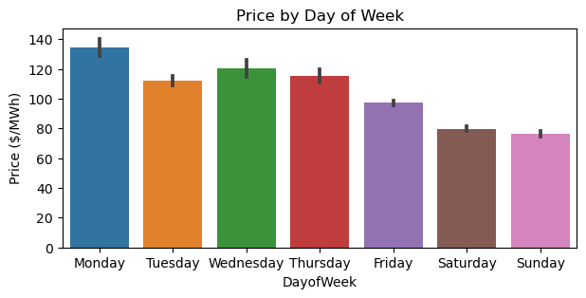
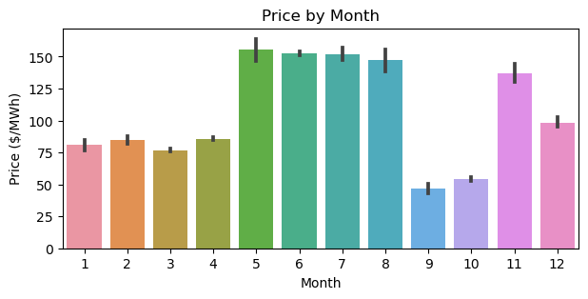
Data Visualisation

Slide 11
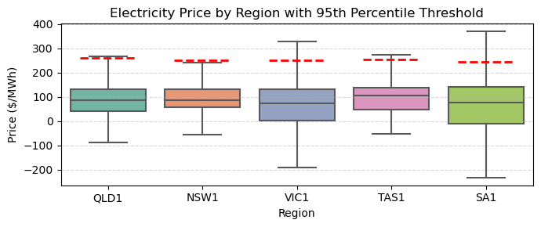
Data Visualisation (cont.)

Slide 12
04
Methodology

Slide 13
Data Splitting
Model Selection
Training dataset: 80% of the dataset used to fit the models and perform hyperparameter tuning.
Testing dataset: 20% of the dataset held out for evaluating the model's generalization ability on unseen data.
Random Forest:
Ensemble method that builds multiple decision trees and outputs the majority vote.
Reduces variance
Less prone to overfitting than a single tree
XGBoost:
Gradient boosting model that builds trees sequentially, each correcting the previous.
High accuracy
Fast and scalable

Slide 14
Hyperparameter Tuning
Model Evaluation
Tuning the max_depth parameter for both Random Forest and XGBoost
Test a range of depth values to select optimal depth based on performance on the test set
Primary Metric: Accuracy
Chosen for its clarity in classifying high-price events correctly
Model Selection:
Compare performance across different max_depth values
Best model has the highest test set accuracy
Interpretability:
Analyze feature importance to identify key drivers of price spikes

Slide 15
05
Interpretation and Findings

Slide 16
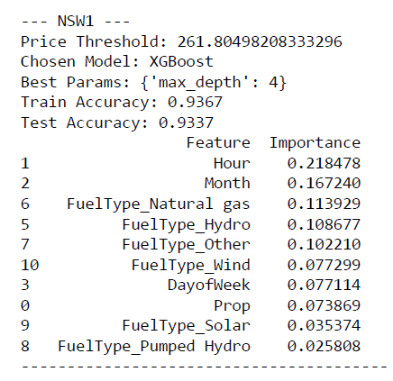
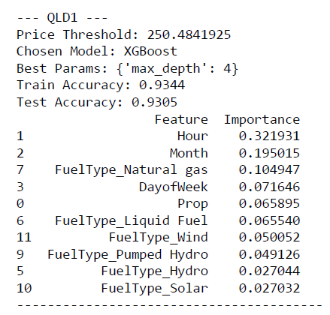
Results

Slide 17
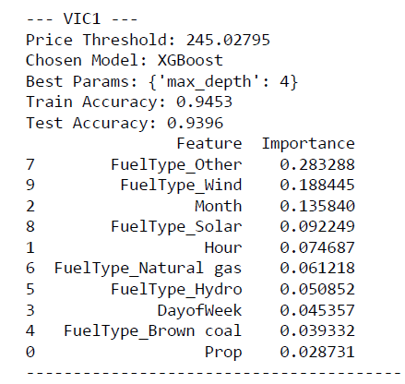
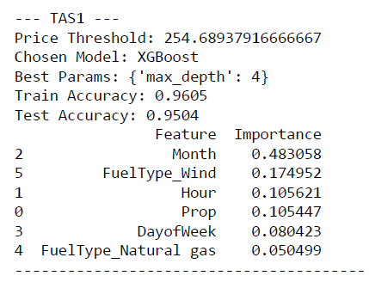
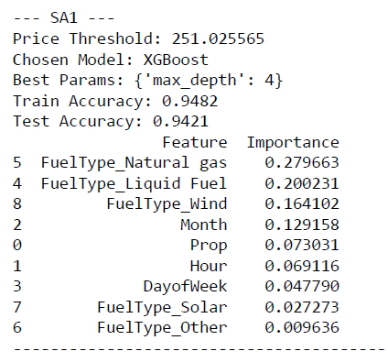
Results (cont.)

Slide 18
Feature Importance
Fossil Fuels — especially gas — are major price drivers
Hydro and Pumped Hydro show mixed hehavior
2
4
1
3
5
Temporal Factors dominate across regions
Wind and Solar — more often linked to lower prices
Dispatch Proportion is less predictive on its own

Slide 19
06
Conclusion

Slide 20
Approach:
Applied supervised machine learning (Random Forest & XGBoost) to one year of hourly NEM data. XGBoost selected for highest accuracy across regions
Findings:
Fossil fuel generators, especially natural gas, are the main drivers of high-price events
Renewables are not the primary cause of price spikes, contrary to some public claims
Implications:
Supports a data-driven view of electricity market behavior
Emphasizes the need for peak demand management, grid flexibility, and better integration of dispatchable resources in Australia’s energy transition

Slide 21
Thanks!
Thi Hau Nguyen
OFF
ON

